Slide 1
U.S. Copyright Law
INFO 4940/5940
Instructor: Mike Priehs
Rights: Reproduction & Modification
March 10, 2025

Slide 2
Refresher
Mechanics of Copyright
Formalities
Duration
Protection

Slide 3
Exclusive Rights - 17 USC § 106
The right to reproduce
The right to create derivative works
The right to distribute copies, or transfer ownership of the work
The right to perform the work publicly
The right to display the work publicly
The right to perform the work publicly via digital audio transmission (if sound recording)

Slide 4
Rights: Reproduction

Slide 5
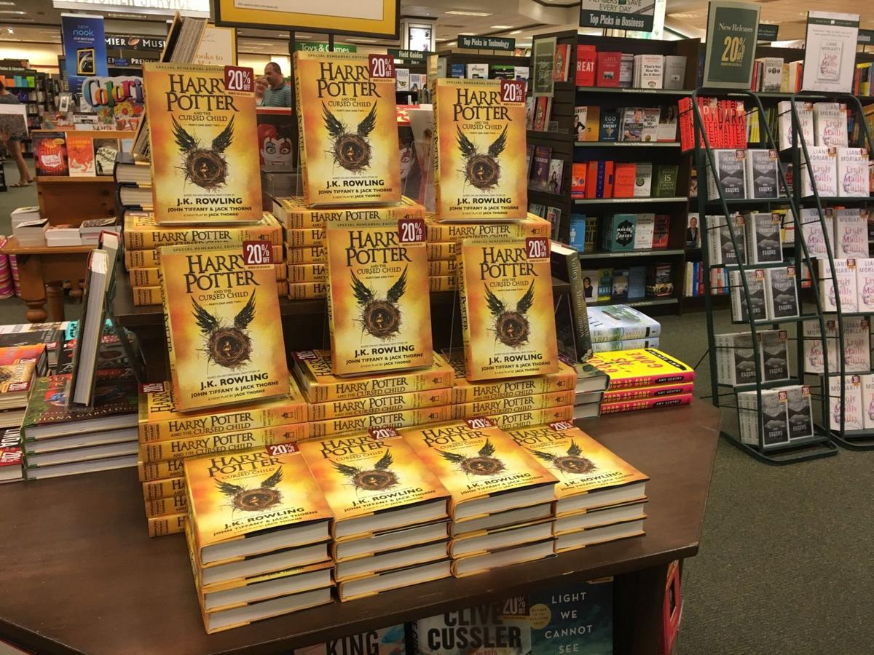
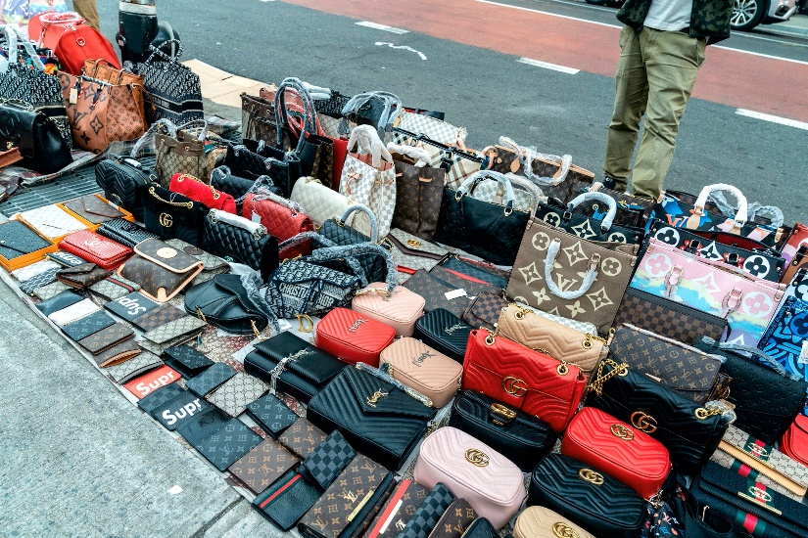
The Right of Reproduction
The right to “copy”
Considered the core of copyright

Slide 6
Three Dimensions of Reproduction
Copying
What the defendant created is a “copy”
Improper appropriation

Slide 7

Fred Fisher v. Dillingham (1924)
Fred Fisher, Inc. claimed that Jerome Kern’s song “Ka-lu-a” misappropriated the accompaniment pattern from their song “Dardanella.”
Dillingham’s primary argument was that Jerome Kern, the composer of “Ka-lu-a,”did not consciously copy the accompaniment pattern from “Dardanella.” Kern testified that he was unaware of any plagiarism and that any similarities were coincidental
“Dardanella”
Felix Bernard & Johnny Black
Fred Fisher, Inc.
“Ka-Lu-a”
Jerome Kern
Dillingham

Slide 8
Judge Learned Hand – Fisher v. Dillingham (1924)
Ruling: Judge Hand found that Kern likely unconsciously copied the accompaniment pattern but awarded minimal statutory damages due to lack of material damage to the plaintiff
Significance: The case highlighted the distinction between patent and copyright infringement, emphasizing that independent creation without copying is not prohibited by copyright law
“Everything registers somewhere in our memories, and no one can tell what may evoke it. Once it appears that another has, in fact, used the copyright as the source of this production, he has invaded the author’s right. It is no excuse that, in so doing, his memory has played him a trick.”

Slide 9
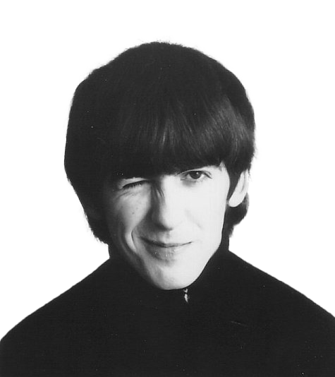
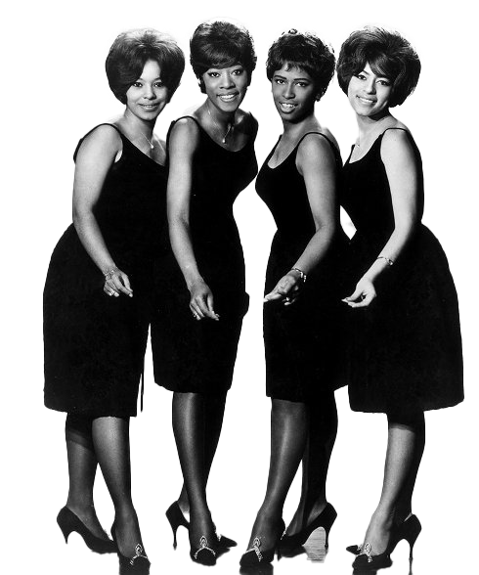
Bright Tunes v. Harrisongs

Slide 10
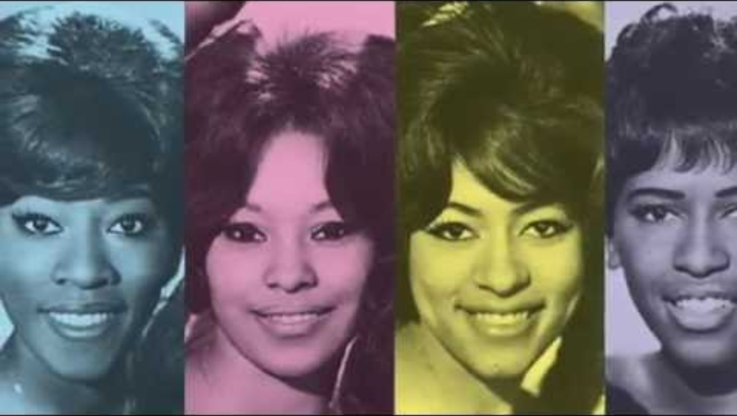

Slide 11
Bright Tunes v. Harrisongs
Ruling:
  Infringement: The court held that "My Sweet Lord" was substantially similar to "He's So Fine" in terms of musical composition.
  Subconscious Copying: The court acknowledged that Harrison did not intentionally copy the song but ruled that subconscious copying still constituted copyright infringement.
Significance:
  Subconscious Copying: This case highlighted that subconscious copying can still be considered copyright infringement, reinforcing the need for creators to be mindful of existing works even if they are not consciously copying them.
  Legal Precedent: The ruling set a significant precedent in copyright law, emphasizing that access to a work and substantial similarity can lead to a finding of infringement, even without intentional copying.

Slide 12
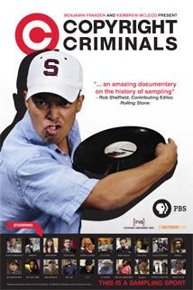
How to Prove Copying
Direct Evidence
Access and Similarity
Striking Similarity
Common Errors

Slide 13
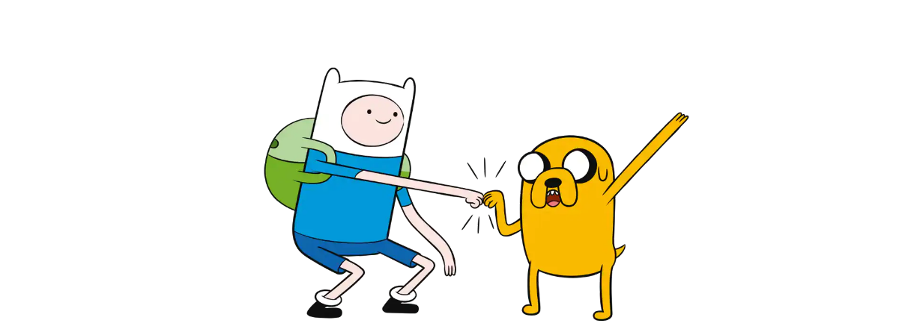
Cartoon Network v. CSC Holdings (Cablevision)
Court: U.S. Court of Appeals for the Second Circuit (2008)
Plaintiff: Cartoon Network, LP, et al.
Defendant: CSC Holdings, Inc. (Cablevision)
Dispute:
Whether Cablevision's Remote Storage DVR (RS-DVR) service infringed on copyright by creating unauthorized copies of television programs.

Slide 14
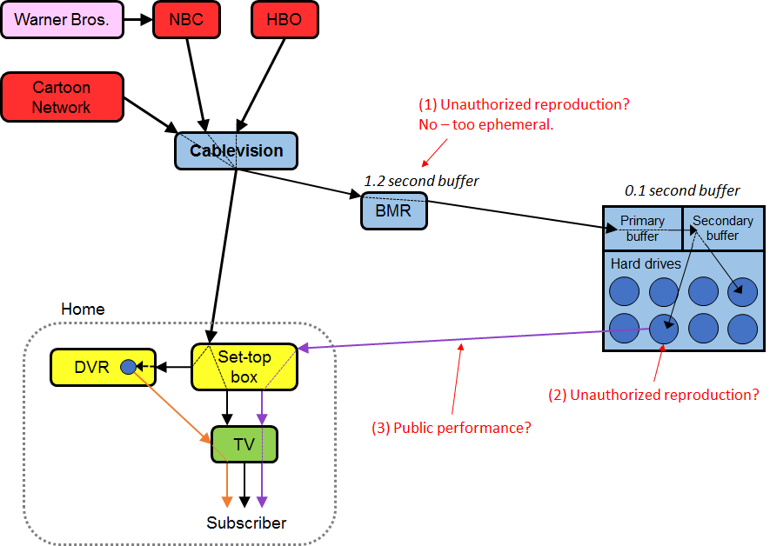

Slide 15
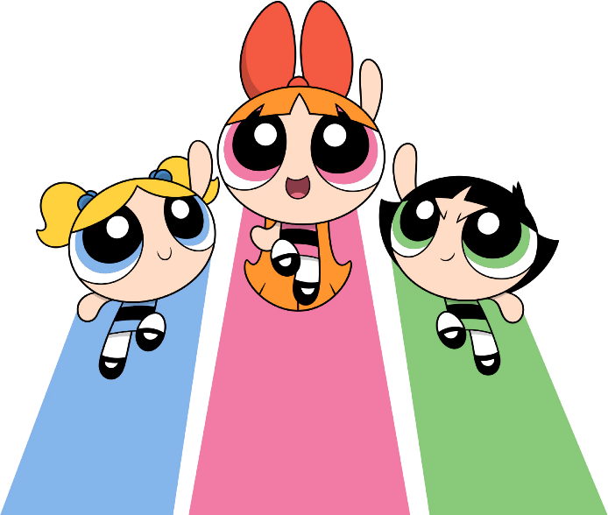
Cartoon Network v. CSC Holdings (Cablevision)
Ruling:
The court ruled that the RS-DVR service did not constitute direct copyright infringement because the temporary data buffering did not create "copies" under copyright law.
Significance:
The decision clarified that transient data buffering does not meet the definition of a "copy" and set a precedent for how digital storage and streaming services are treated under copyright law.

Slide 16
Rights: Reproduction
Improper Appropriation

Slide 17
Methods to Show Improper Appropriation
Comprehensive copying
Fragmented literal similarity
Comprehensive nonliteral similarity (“substantial similarity” test)

Slide 18
Fragmented Literal Similarity
Must show two things in addition to copying
That the slice the defendant took includes some copyrightable expression, not merely ideas or facts
That the slice the defendant took is big enough

Slide 19
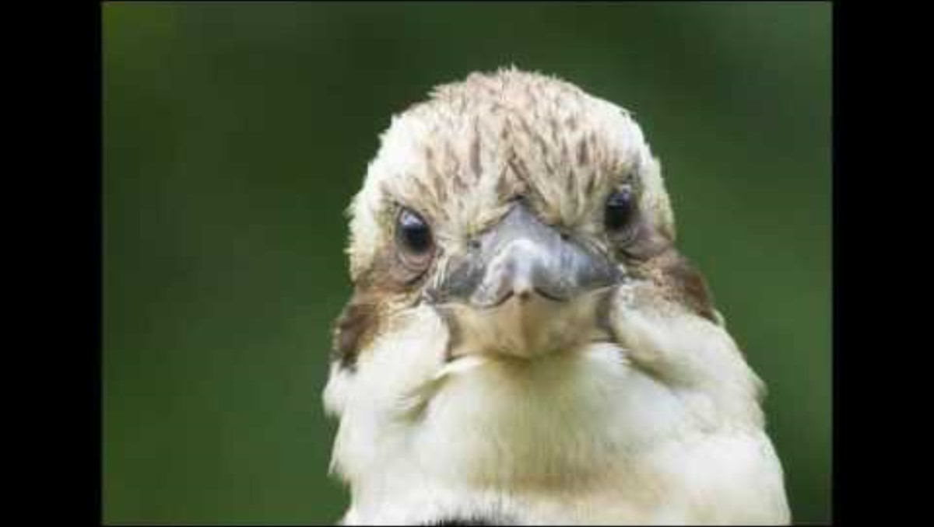
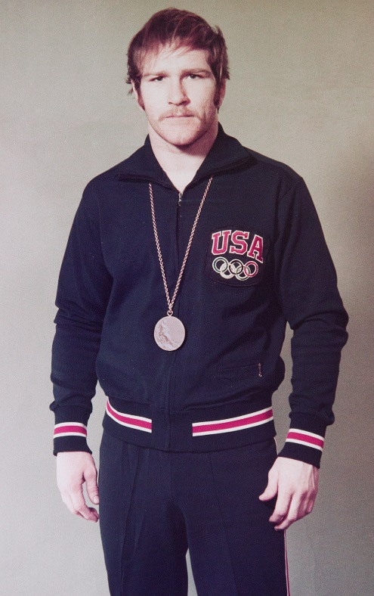
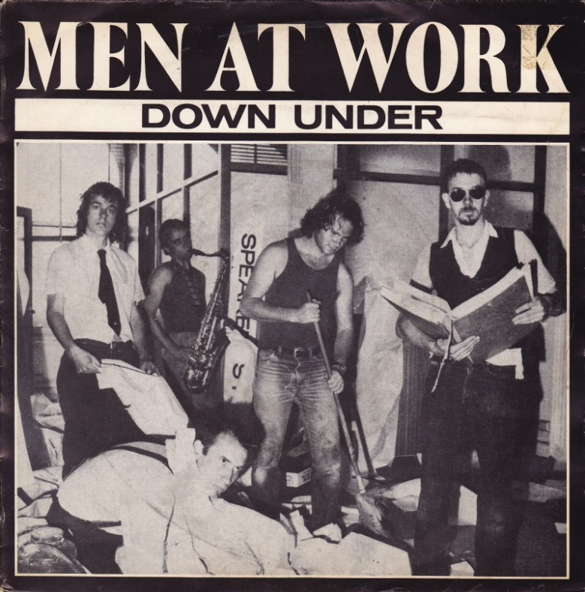
Fragmented Literal Similarity
https://www.stereogum.com/2089242/the-number-ones-men-at-works-down-under/columns/the-number-ones/
https://www.imdb.com/name/nm0300086/

Slide 20
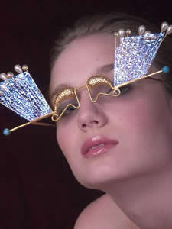
Davis v. The Gap: De Minimus Doctrine
http://omomisha.com/Onoculii.html

Slide 21
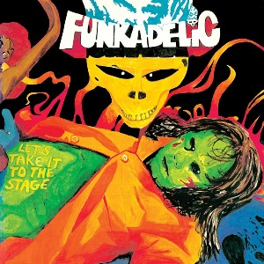
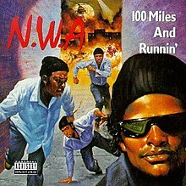
Bridgeport Music v. Dimension Films
"Get a license or do not sample. We do not see this as stifling creativity in any significant way.“
https://en.wikipedia.org/wiki/Let%27s_Take_It_to_the_Stage
https://en.wikipedia.org/wiki/100_Miles_and_Runnin%27

Slide 22
Comprehensive Nonliteral Similarity
involves situations in which the defendant has not copied any portion of the plaintiff’s work verbatim, but has instead created a different but similar work

Slide 23
Comprehensive Nonliteral Similarity
Two Threshold Questions:
Can a defendant escape liability by showing they added sufficient things to the plaintiffs work to make the two works different?
What happens when the plaintiff’s work contains some material protected by copyright and some material that’s not protected?

Slide 24
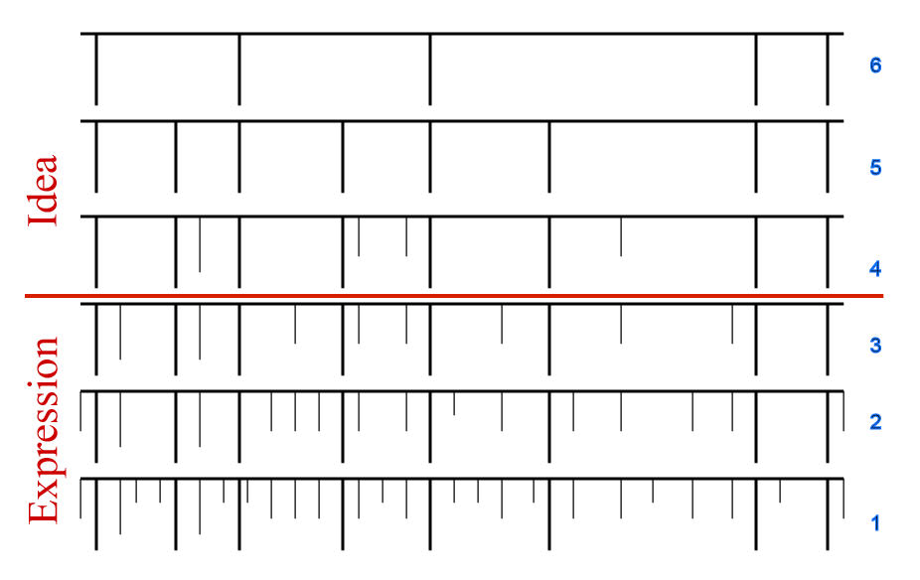
Nichols “Pattern” Test

Slide 25
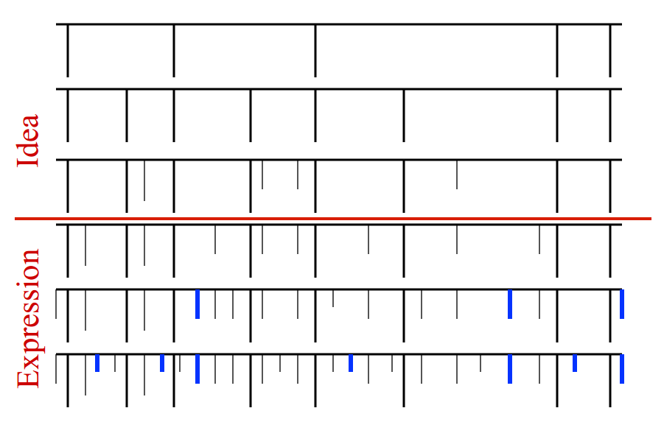
Computer Associates International v. Altai
Pattern test for software, step 1 – remove elements dictated by efficiency

Slide 26
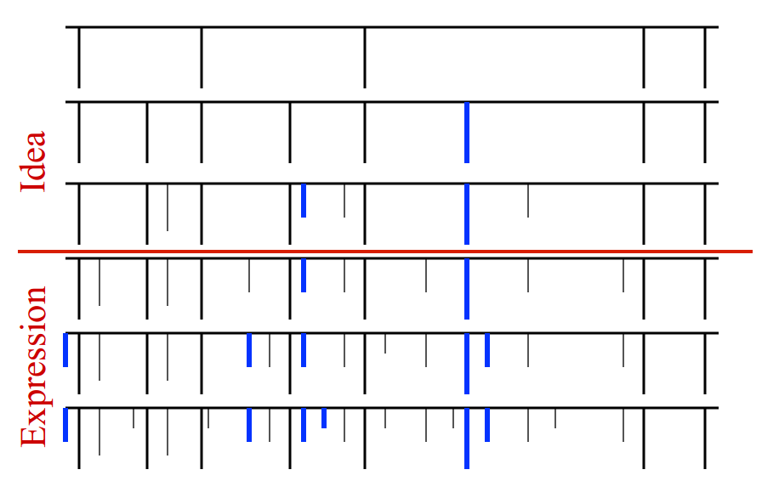
Computer Associates International v. Altai
Pattern test for software, step 2 – remove elements dictated by external factors

Slide 27
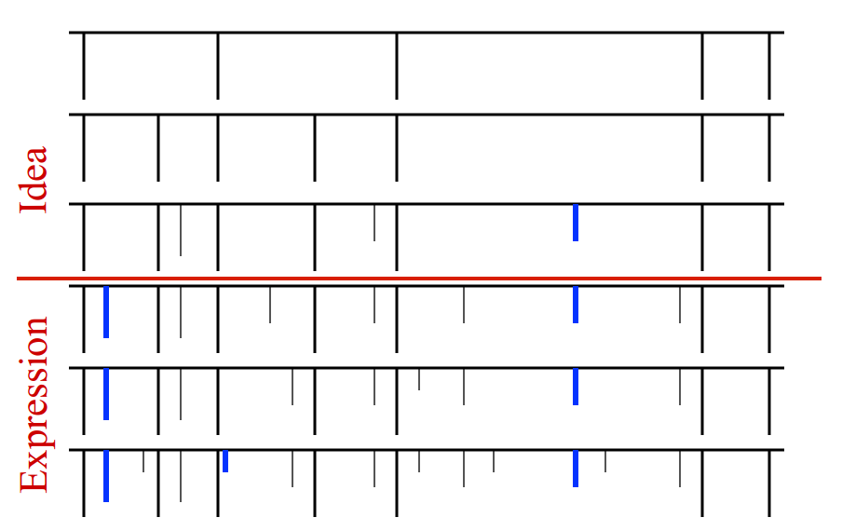
Computer Associates International v. Altai
Pattern test for software, step 3 – remove elements taken from public domain

Slide 28
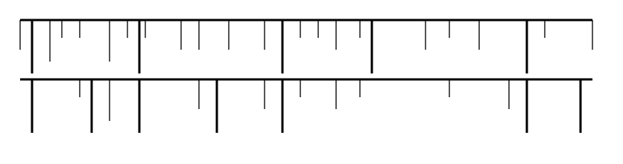
Computer Associates International v. Altai
Pattern test for software, step 4 – compare elements of defendant’s program vs protected parts of plaintiff’s program

Slide 29
Level of Similarity to Trigger Liability
“Same aesthetic appeal”
Apparent appropriation
“Total concept and feel”
Extrinsic/Intrinsic Test

Slide 30
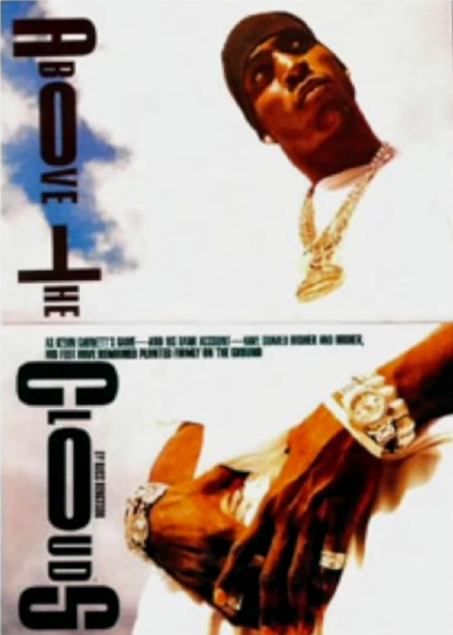
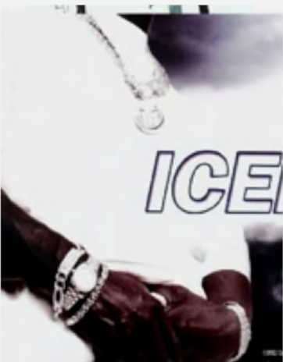
“Same Aesthetic Appeal”
Mannion v. Coors

Slide 31
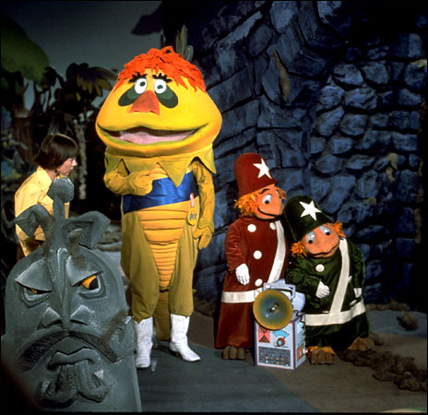
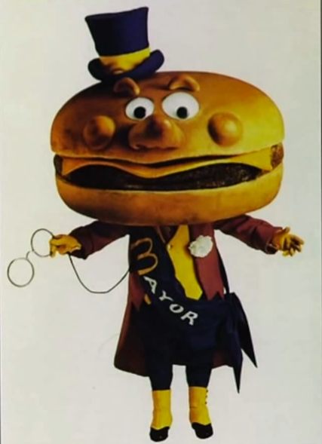
“Total Concept and Feel”
Krofft v. McDonald’s

Slide 32
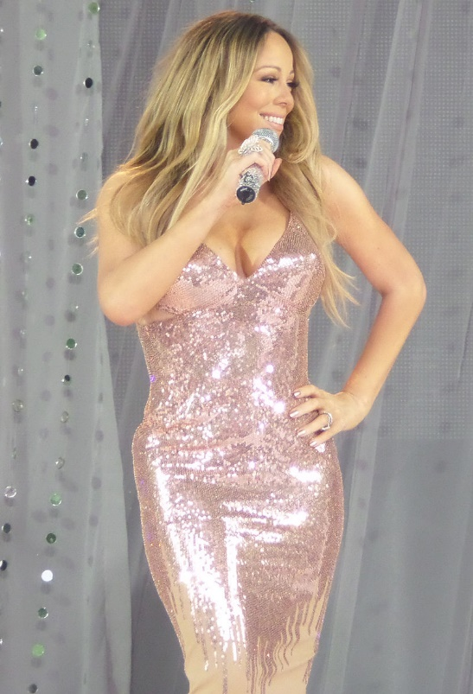
Extrinsic/Intrinsic Test
Extrinsic test
Compares the general ideas of the two works
Focuses on the protectible elements of the plaintiff's expression
Objectively considers whether there are substantial similarities in both ideas and expression
Intrinsic test
Compares the protectable aspects of the plaintiff's work to the defendant's work
Measures if there is substantial similarity in the protectable expression of both works
Subjectively measures expression
Determines whether both works are substantially similar in “total concept and feel”
https://en.wikipedia.org/wiki/Mariah_Carey#/media/File:MariahGMA.jpg

Slide 33
Rights: Reproduction & Modification
Derivative Works

Slide 34
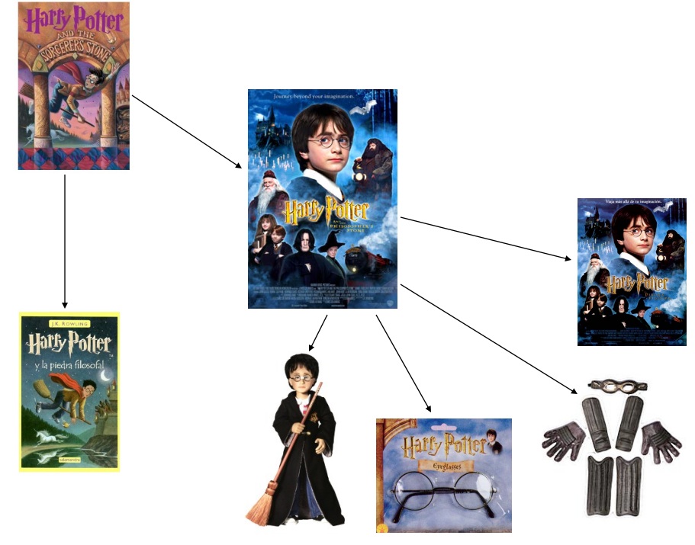

Slide 35
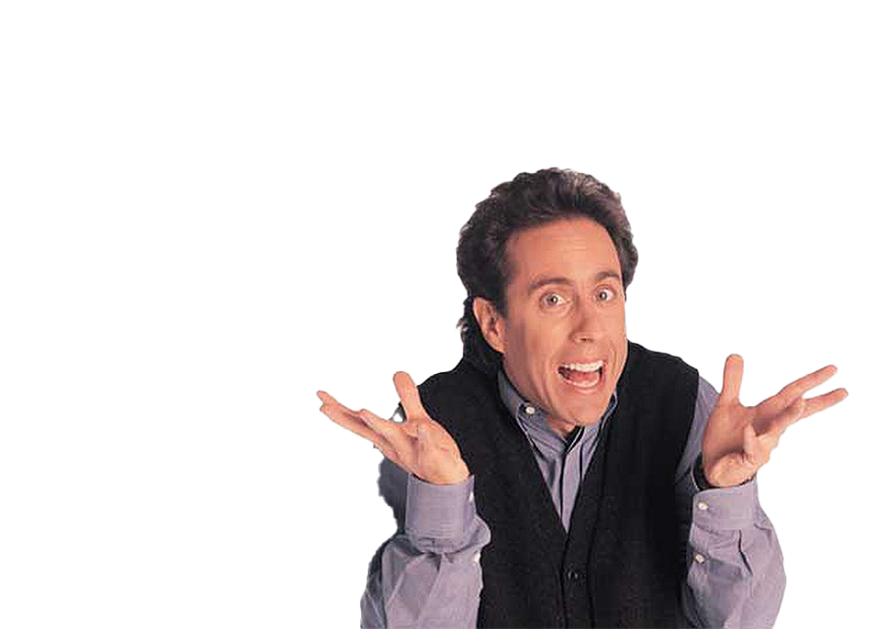
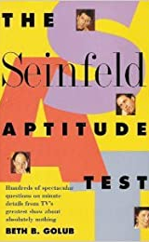
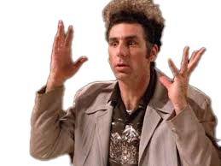
Castle Rock Entertainment v. Carol Publishing
https://www.amazon.com/Seinfeld-Aptitude-Test-Spectacular-Absolutely/dp/080651583X

Slide 36
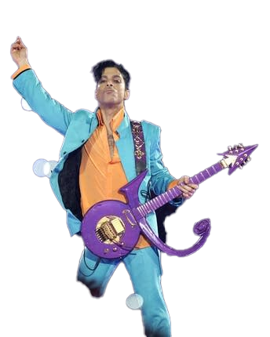

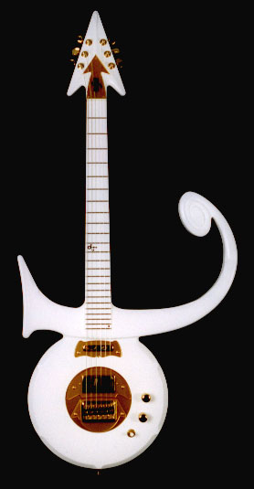
Pickett v. Prince

